Slide 1
Employee Salary Prediction Using Machine Learning
CAPSTONE PROJECT
Presented By:
1. GOLLA ADISESHU – Birla Institute of Technology And Science, Pilani (BITS)(Design & computing )

Slide 2
OUTLINE
Problem Statement
System Development Approach
Algorithm & Deployment (Step by Step Procedure)
Result
Conclusion
Future Scope
References

Slide 3
Problem Statement
Accurately estimating employee salaries is a complex task influenced by multiple factors such as experience, education, gender, and job role. In the absence of data-driven tools, salary decisions often lack consistency and fairness. This project addresses the issue by developing a machine learning model that predicts employee salaries based on key attributes, promoting transparency and informed decision-making in compensation planning.

Slide 4
System Approach
System Requirements:
Component | Specification
OS | Windows / macOS / Linux
Python Version | Python 3.8 or above
RAM | Minimum 4 GB (Recommended: 8 GB)
Disk Space | ~200 MB (code + model + dataset)
Internet | Required for dataset access & deployment
IDE (optional) | VS Code / Jupyter / PyCharm

Slide 5
System Approach
Libraries Used:
Library | Purpose
pandas | Data handling and pre-processing
NumPy | Numerical operations
scikit-learn | ML model training, scaling, encoding, metrics
joblib | Saving/loading trained model
streamlit | Building the web app frontend
matplotlib | Plotting evaluation graphs
seaborn | Advanced data visualizations
PIL (Pillow) | Displaying evaluation image in Streamlit
🔧 You can install all with:
pip install pandas numpy scikit-learn streamlit matplotlib seaborn joblib

Slide 6
Algorithm & Deployment
Step 1: Dataset Collection
Source: Kaggle – “Salary Prediction for Beginners”
Fields: Age, Gender, Education Level, Job Title, Years of Experience, Salary
Step 2: Data Pre-processing
Label Encoding for categorical features
Scaling numerical fields with StandardScaler
Removed any missing or inconsistent data

Slide 7
Algorithm & Deployment
Step 3: Model Building
Algorithm: Linear Regression (from Scikit-learn)
Model trained on pre-processed data
Evaluation metrics:
R² Score: 0.8911
MSE: 205,754,135.71
Step 4: Model Saving
Model, encoders, and scaler saved using joblib into “salary_predictor.pkl”

Slide 8
Algorithm & Deployment
Step 5: Web App Development
Built a responsive “Streamlit” interface
Input form collects 5 key employee details
Predicts and displays annual salary in USD and INR
Shows evaluation plot and model metrics
Step 6: Deployment
Deployed on “Streamlit” Cloud
Accessible at: 👉 employee-salary-predictionbygirish.streamlit.app

Slide 9
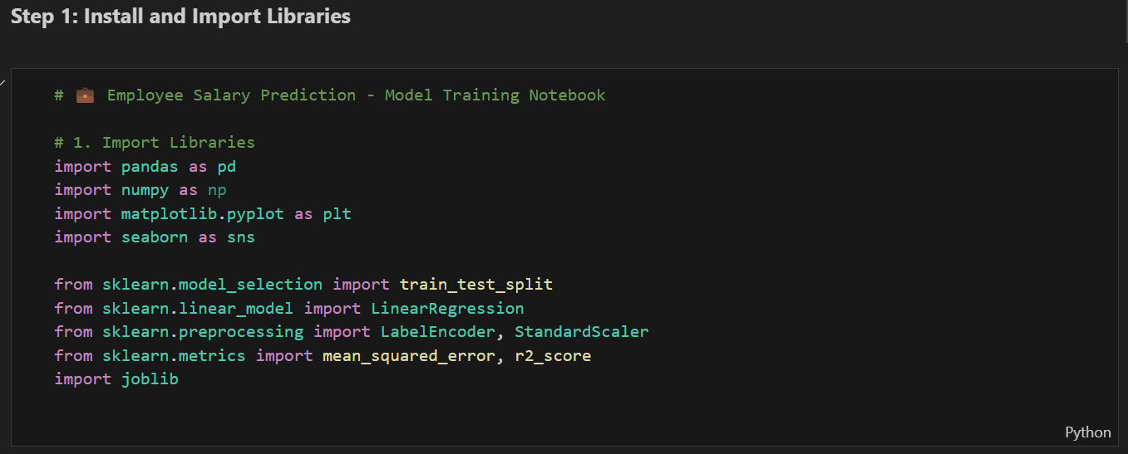
Result
Importing Required Libraries

Slide 10
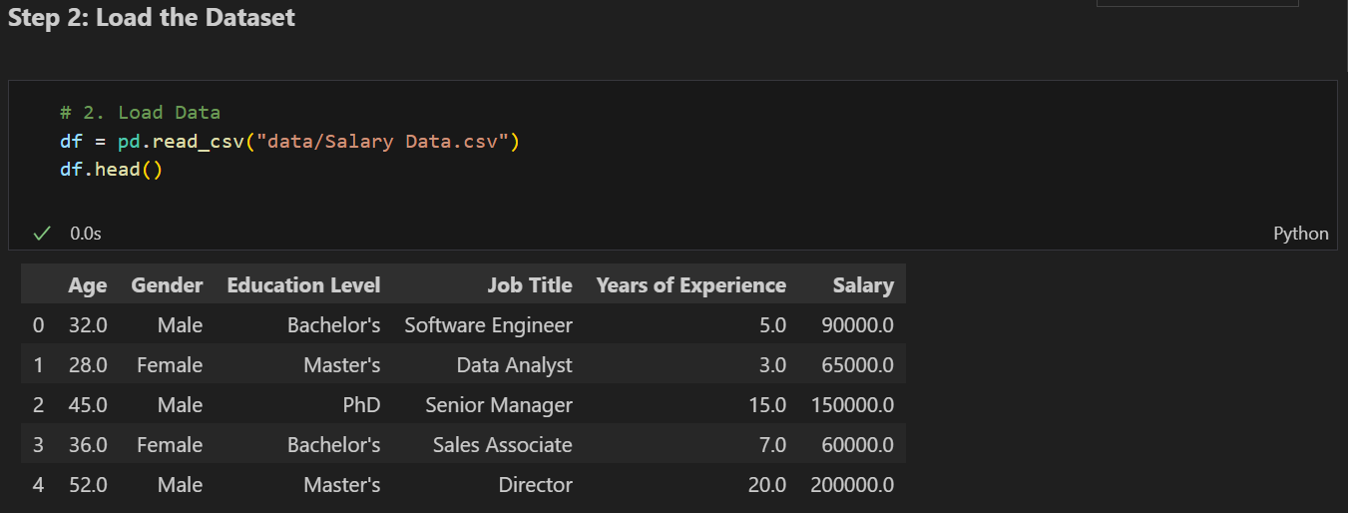
2. Loading the Dataset

Slide 11
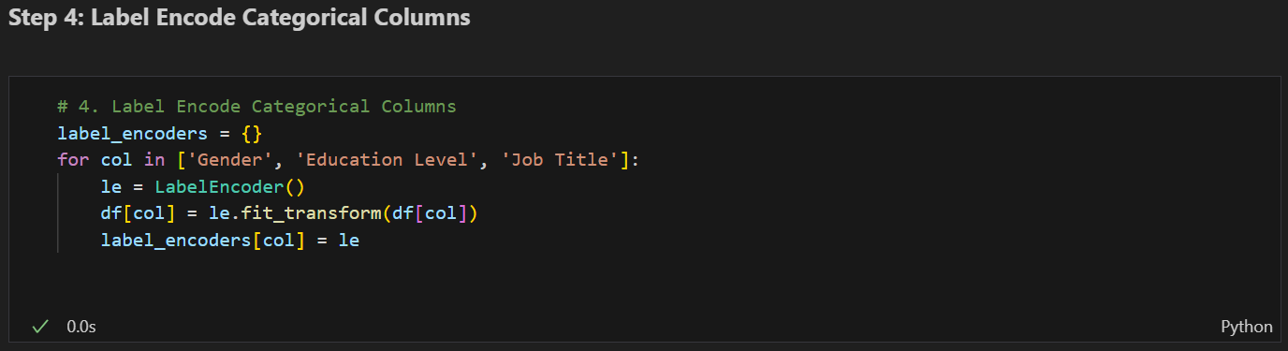
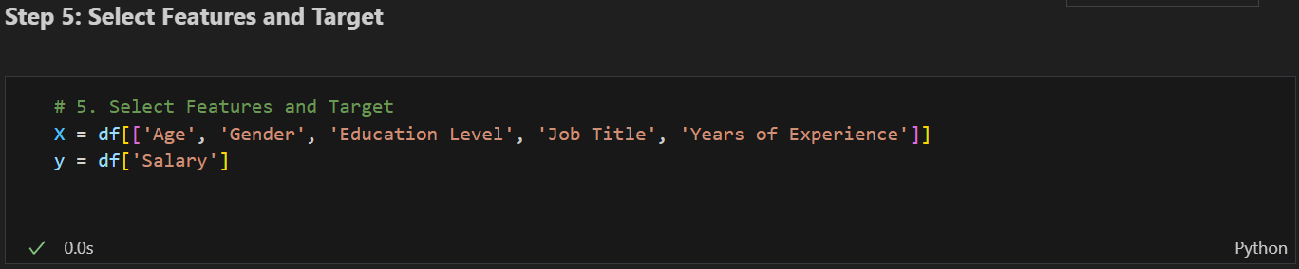
3. Data Pre-processing & Label Encoding
4. Feature Selection

Slide 12
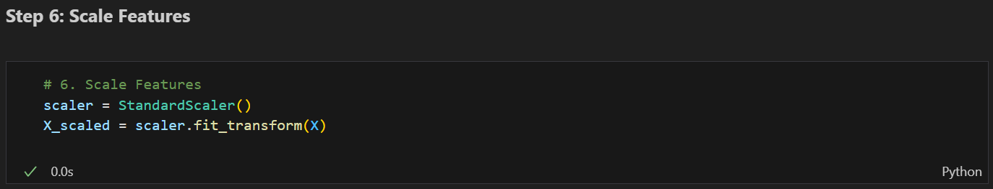
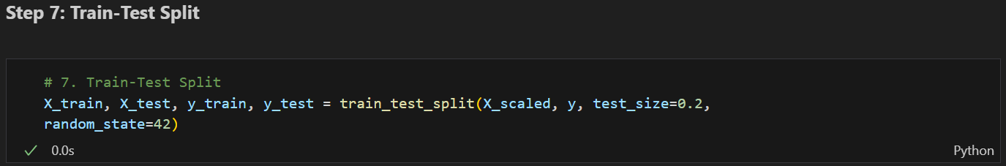
5. Scale Feature
6. Splitting the Dataset

Slide 13
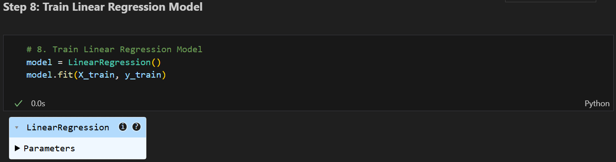
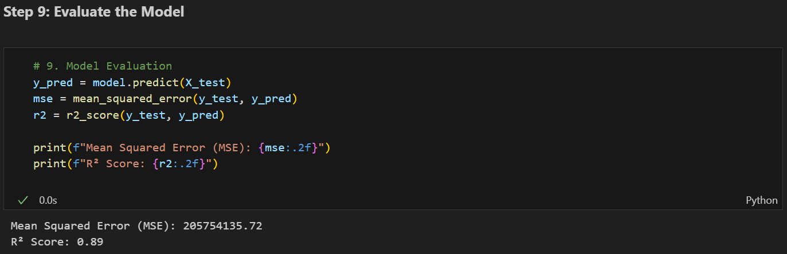
7. Model Training & Model Evaluation

Slide 14
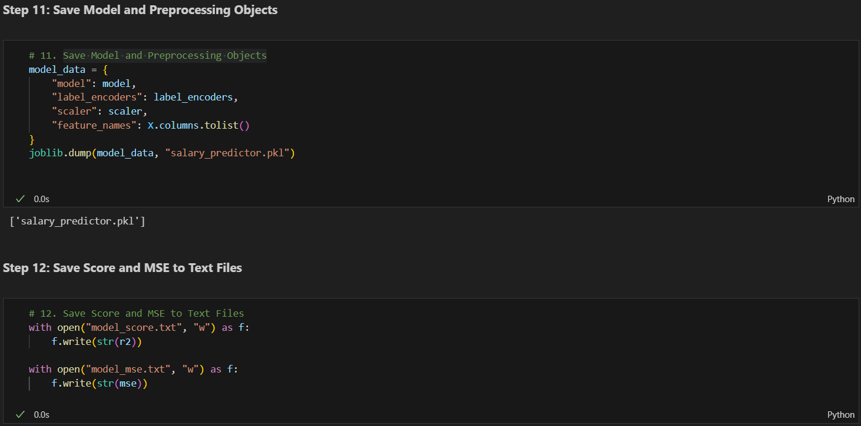
8. Saving Model And the Evaluation Metrics

Slide 15
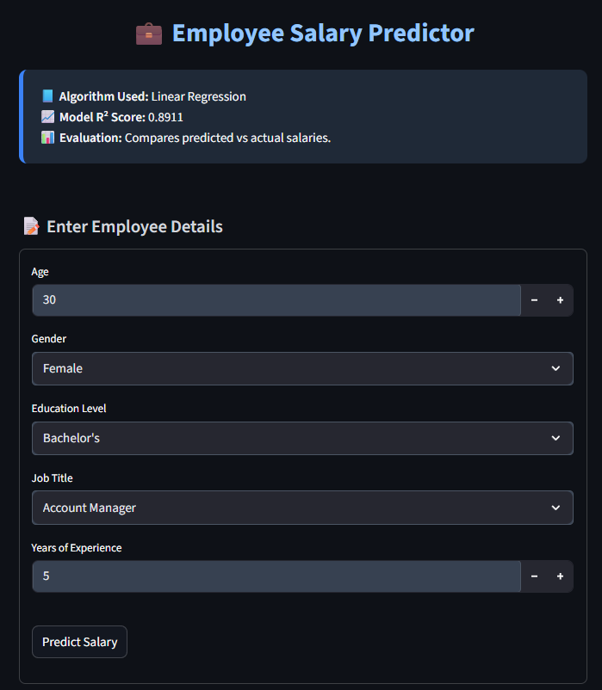
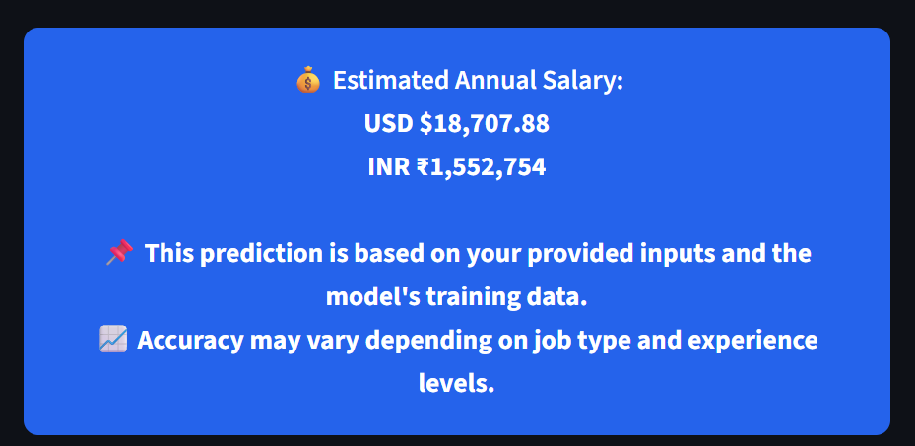
9. Streamlit UI: Input Form & Salary Prediction Output
Try it On:
https://employee-salary-predictionbygirish.streamlit.app/

Slide 16
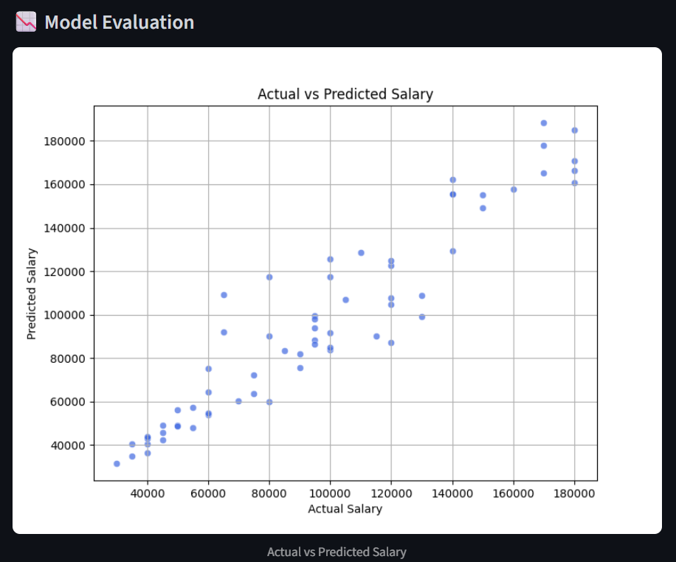
10. Model Evaluation Plot
GitHub Repository Link:
https://github.com/G1r1shCodes/Employe-Salary-Prediction-Using-ML

Slide 17
Conclusion
This project successfully demonstrates how machine learning can be used to predict employee salaries based on personal and professional attributes.
A Linear Regression model was trained using a real-world dataset with a high R² Score of 0.8911, indicating strong prediction accuracy.
The project integrates both data science and web development, using Scikit-learn for modelling and Streamlit for an interactive user interface.
It provides a practical tool for job seekers, HR professionals, and organizations to estimate fair compensation.
Overall, this solution brings transparency, efficiency, and data-driven decision making to the salary prediction process.

Slide 18
Integrate more features like location, company type, skills.
Add support for classification-based roles (e.g., full-time vs intern).
Enhance model with more complex regressors (e.g., XGBoost, Ridge).
Make UI mobile-friendly with dark/light themes.
Add a salary trend dashboard to visualize insights across roles and industries.
Future scope

Slide 19
References
Kaggle Dataset: Salary Prediction for Beginners
Scikit-learn Documentation: https://scikit-learn.org/
Streamlit Documentation: https://docs.streamlit.io/
Matplotlib & Seaborn (for visualization): https://matplotlib.org/ https://seaborn.pydata.org/
GitHub Repository (Project Code): https://github.com/GollaAdiseshu/Salary_-prediction

Slide 20
THANK YOU

